Slide 1

Social network models of diffusion
Ryan, B. and N.C. Gross (1943) The Diffusion of Hybrid Seed Corn in Two Iowa Communities, Rural Sociology, 8: 15-24.

Slide 2
Models of diffusion
Growth model
  fast diffusion, not S shaped, no network
Global Threshold Models (Granovetter 1978; Macy 1991)
  No network, non-adjacent diffusion, S shaped
Contagion/Cohesion (Coleman et al 1966; Rogers 1962)
  Simple contagion, S shaped, network
  Christakis and Fowler
Structural Equivalence (Burt 1987)
  S shaped, non-adjacent diffusion, similarity = f(network position)
Network Threshold Models (Valente 1996)
Weak ties and Small World (Granovetter 1982, Watts & Stogatz 1998)
  network has clustering with short cuts
Complex Contagion Models (Centola & Macy 2007)

Slide 3
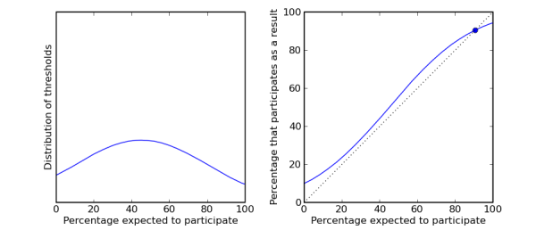
Global threshold models
In the (global) threshold model of diffusion (Granovetter 1978) q (the probability of adoption/participation)is a function of
  the proportion of persons in the system that have already adopted/participated
  personal qualities such that q(i) has a distribution

Slide 4
Global threshold models
Persons with low thresholds are high risk early adopters
Persons with high thresholds are risk averse late adopters
Variance in thresholds explains the typical S-shaped pattern of cumulative adoptions with initial slow uptake, rapid spread and slow saturation.

Slide 5

Global threshold models
Rogers, E.M.(1962) The Diffusion of Innovations, Free Press, New York.

Slide 6
Global threshold models
The Innovators and Early adopters are individuals whose time-of-adoption is greater than one standard deviation earlier than the average time-of-adoption.
The early and late majorities are individuals whose time-of-adoption is bounded by one standard deviation earlier and later than the average.
Laggards are those individuals who adopted later than one standard deviation from the mean

Slide 7
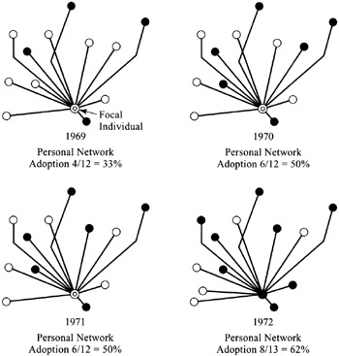
Network threshold models
The network threshold model relaxes the assumption that persons have global information on all adoptions in the system
  Global threshold models are appropriate for adoptions of behaviors that are public and observable

Slide 8
Network threshold models
However, may be inappropriate for the adoption of innovations that are not directly observable
Individuals may monitor only a subset of actors in the system, namely those that they are connected to

Slide 9
Network threshold models
Particularly appropriate when adoption behavior entails uncertainty and risk
An individual's exposure is given by the proportion of her neighbors that have already adopted

Slide 10
Network threshold models
Each individual is endowed with a given threshold q(i)
  When the proportion of neighbors who have adopted equals q(i), the person adopts
  We can then redefine adopter categories (e.g. innovators) as either
    System relative
    Network relative

Slide 11
Network threshold models
Early adopters (or laggards) relative to their network may not be early adopters relative to the system
  For instance, if a high q individual's network is composed entirely of innovators, he will be a laggard relative to his peers but an innovator relative to the system
  In the same way a low-q individual who belongs to an isolated clique will be a laggard relative to the system but an early adopter relative to his peers

Slide 12
Network threshold models
A key finding in classic diffusion research is that early adopters are more likely to have external (media, weak ties) sources of influence, while late adopters are more subject to network effects (Rogers 1962)
  This seems to reflect a local/Cosmopolitan split
Considering both system-level and personal network threshold clarify this relationship
  Cosmopolitan innovators tend to be early adopters relative to the system and have very low threshold relative to their network

Slide 13
Network threshold models
The network threshold model allows to come up with a more nuanced classification of early and late adopters
System Threshold
Low High
Low
High
True innovators (influentials) | Isolates
Connected Bandwagon | Resistant rearguard
Network Threshold

Slide 14
Network threshold models
Opinion leaders are relative to their system-level adopter category:
  Early adopters who convince those with high network thresholds (but similar system threshold) to adopt
System Threshold
Low High
Low
High
True innovators (influentials) | Isolates
Connected Bandwagon | Resistant rearguard
Network Threshold

Slide 15



Network Threshold Models
Cross-sectional Model
Lagged panel data model
Event History (Hazard Rate Model)
  Can control for (1) focal node network properties like in and out degree and (2) non-adjacent “networked” traits

Slide 16
Contagion/Influence:
Christakis & Fowler
Behavioral (trait) clustering in networks - 3 explanations
  Choice homophily
  Confounding contextual effects
  Influence (adjacent contagion)
Lagged panel data model
  Ego obesity (t+1) = f(ego attributes, ego obesity(t), alter’s obesity (t and t+1)
  alter obesity (t) controls for homophily
  influence if alter obesity (t) → ego obesity (t)

Slide 17
Contagion/Influence:
Christakis & Fowler
Results
  Risk of obesity 45% higher if connected to an obese ego (1-hop)
  20% higher is 2-hops from obese person, 10% for 3-hops
Eliminating Confounding Factors
Direction of friendship: mutuals 171%, ego stated (57%), alter stated (0%)
Increasing social distance decreases effect of alter on ego, increasing geographical distance does not
No neighbor effects

Slide 18
Complex contagion
We have seen that heterogeneity in the propensity to adopt an innovation can be modeled as a threshold process
However, thresholds may not be fixed for individuals regardless of what is being diffused
Instead, persons may modulate their thresholds depending on characteristics of the innovation that is being transmitted through the network

Slide 19
Complex contagion
Innovations that entail risk, ostracism, potential loss of resources, may elicit higher thresholds from all actors in the network
  Persons require exposure to multiple sources to adopt
Innovations (e.g. gossip) that carry little risk may in their turn elicit a very low threshold
  In the limiting case, the person adopts as soon as one of their neighbors adopts
This is the difference between simple and complex contagion
  The basic idea is that certain innovations can only diffuse via complex contagion

Slide 20
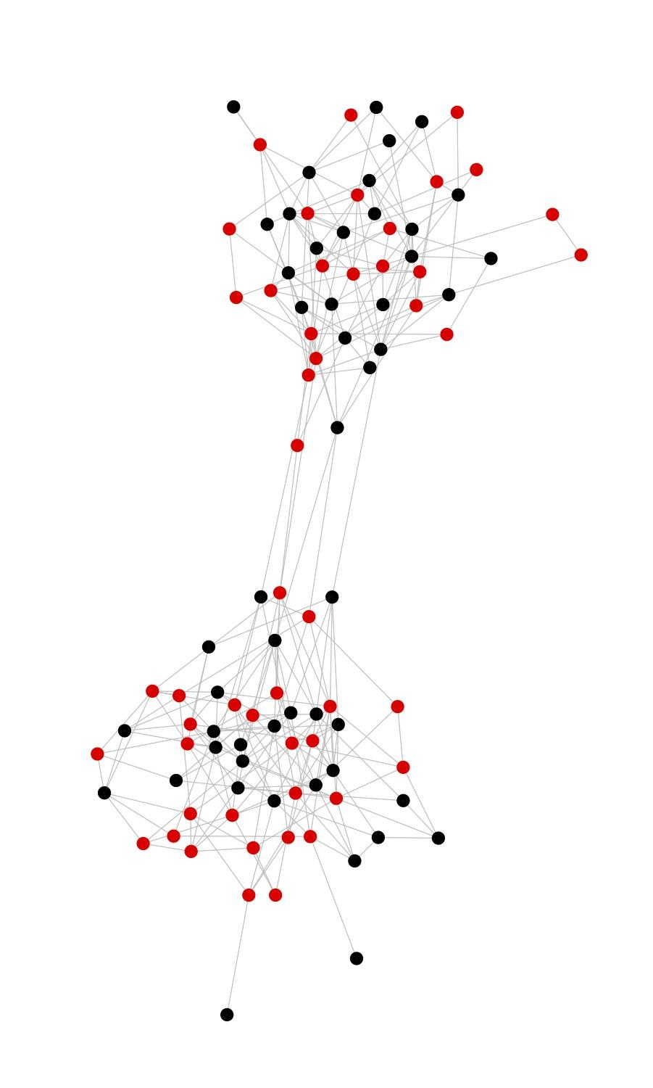
Complex contagion
Examples of simple contagion:
  Information, disease
Examples of complex contagion:
  High risk social movement participation, religious conversion, migration, etc.

Slide 21
Complexcontagion
Four social mechanisms that require that innovations diffuse via complex contagion:
  Strategic complementarity: adoption cost declines as a function of existing adopters
  Legitimacy: Resistance to challenge, collective acceptance, and taken-for-grantedness increases with the number of adopters

Slide 22
Complex contagion
Four social mechanisms that require that innovations diffuse via complex contagion:
  Credibility: Adoption of innovation more likely when confirmed by many others
  Emotional contagion: Cumulative interaction with a large number of adopters leads persons to adopt

Slide 23
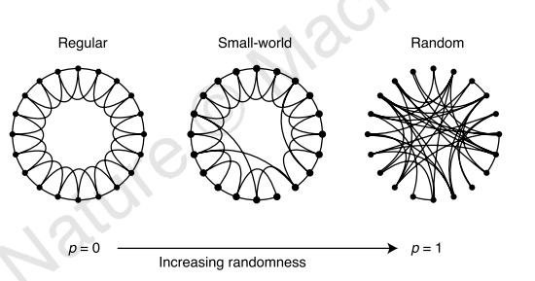
Simple Contagion
Watts & Strogatz - random rewiring creates long (weak) ties
  small world with clustering
  works for simple contagion

Slide 24
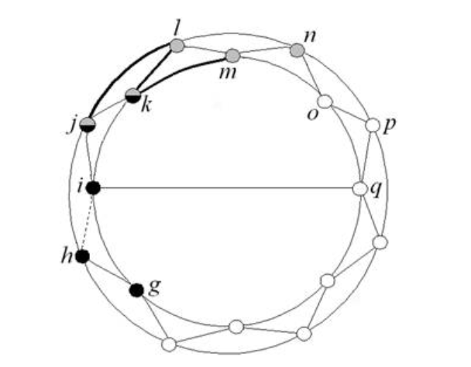
Complex Contagion
Weakness of long ties
  Network threshold model (adoption requires more than 1 time exposure (multiple alters)) because weak ties need confirmation
  Bridges (long ties) must be wide

Slide 25
Complex Contagion
Problem
  Long ties non-transitive
  Rewiring breaks bridges
  Simulations show if threshold > 2 alters, no diffusion
    Need wider bridges, but random rewiring unlikely to create them
    Break existing bridges

